Slide 1
Agile Software Development
- Prof K G Krishna

Slide 2



Text/Reference Books
T1
T2
Compliments of IBM
➔ As this field is evolutionary, the student is advised to stay tuned to the current and emerging practices by referring to their own organization’s documentation as well as Net sources

Slide 3
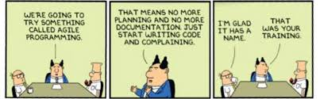
Topics
Basics of Agile Software Development
Iterative and Incremental Approaches
Risk driven and client driven development
Time-boxed development
Adaptive and Evolutionary development
© Scott Adams

Slide 4
Customer Requirements? Hard To Get!
“Ours is a world where people don't know what they want and are willing to go through hell to get it.”
—Don Marquis
“Requirements are capabilities and conditions to which the system—and more broadly, the project—must conform”
“A prime challenge of requirements analysis is to find, communicate, and remember (that usually means write down) what is really needed, in a form that clearly speaks to the client and development team members.”
More than 50% of Requirements keep changing through the Development cycle (particularly true while working with Oriental Customers like Japanese)

Slide 5
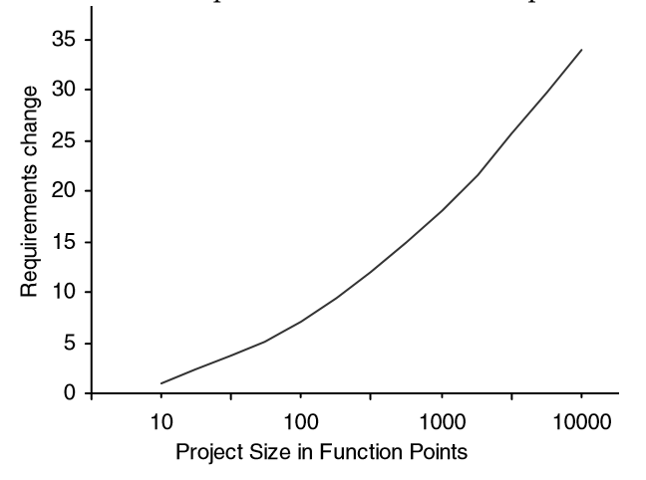
Waterfall is nightmare…Don’t Go For It!

Slide 6
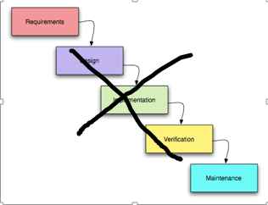
The ills of Waterfall…
Originated in the Mainframe era (suited for Large Enterprise Projects)
Freezing Requirements Upfront (Reality is different)
Long Project Life-cycles (>>2 years)
Lack of Transparency and Visibility to Customer
“Last-minute surprises to Customer upon Delivery”
Documentation overhead (“non-value-adding?”)
“Work fills available schedule”
Hierarchical Team Structures
…

Slide 7
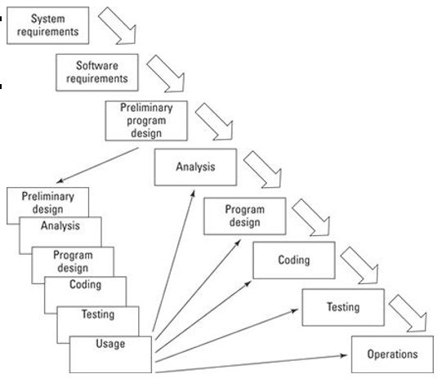
Iterations in Waterfall? No Good Either…
“We Don’t Know Everything When We Start The Project…”

Slide 8
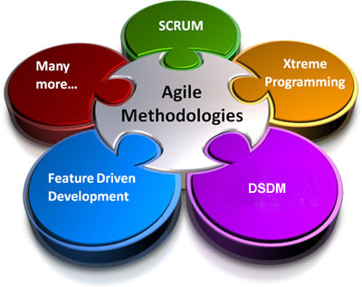
Iterative & Incremental…is the Way To Go!
You should use iterative development only on projects that you want to succeed.
—Martin Fowler
Early Programming & Testing of Partial System, in Repeating Cycles in Agile vs. Early Upfront Speculative Requirements Freeze before Programming in Waterfall Models
Refinement of the System through Successive Fixed-length Iterations (mini-projects or Sprints)
Common Agile Processes: Scrum, Lean Development, Unified Process, Test-Driven Development (TDD), Feature-Driven Development (FDD), Adaptive Software Development, etc.

Slide 9
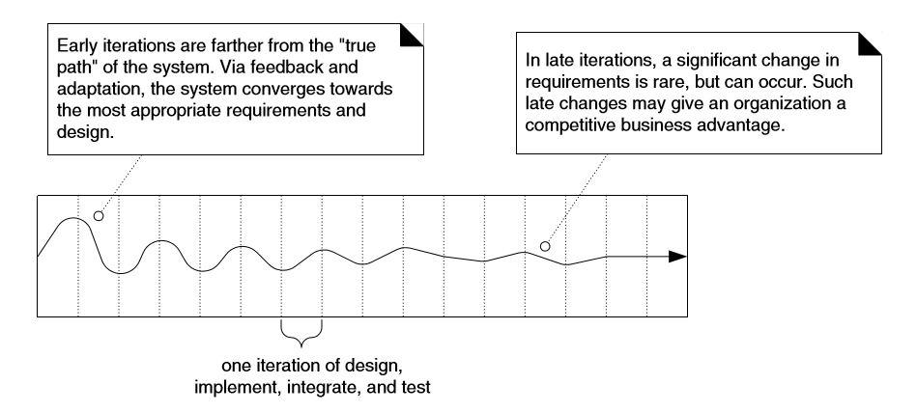
Iterations Converge to True Requirements!
NO ‘Waterfall Thinking’ in Iterative Development! “…on average 45% of the features in waterfall requirements are never used, and early waterfall schedules and estimates vary up to 400% from the final actuals…”

Slide 10
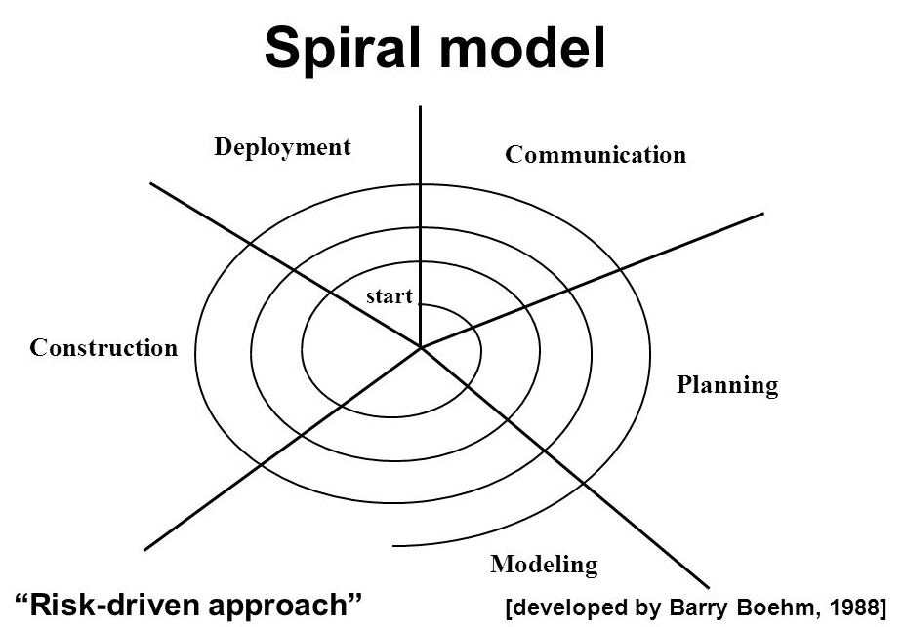
Risk-Driven, Customer-Driven Iterative Planning
Early Iterations with Highest Risk
Ensure Early Visibility of Key Features
Focus on Stabilizing Architectural Choices

Slide 11
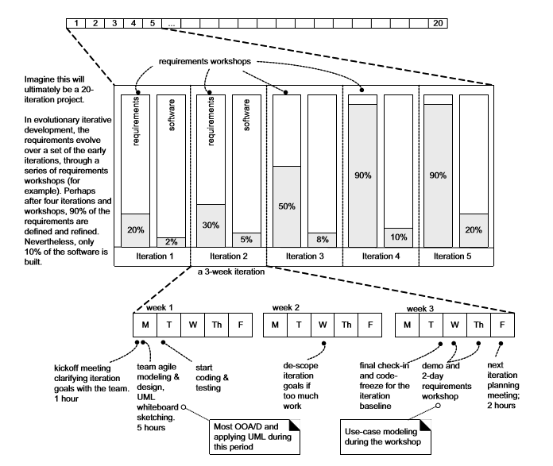
Evolutionary Analysis & Design in Early Iterations

Slide 12
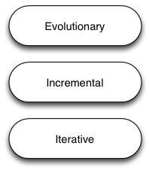
Typical Iteration includes…
Well-defined, Prioritized Set of Requirements
Time-boxed Schedule (Deadline = ‘Dead’line!)
Output Deliverable: Tested, Integrated and Partial Usable System
Each Iteration includes its own Requirements Analysis→Design→Programming→…→Testing Cycles (mini-waterfall)
Incorporates Feedback (from Customer and other Key Stakeholders) after every Iteration

Slide 13
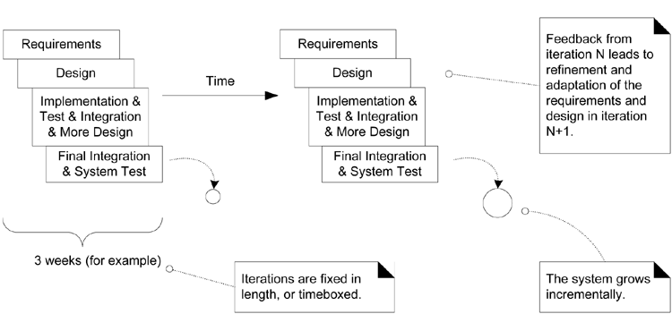
Time-Boxed Iteration with Feedback

Slide 14
Let’s Review Few Popular Agile Methods:
(Lean, Extreme Programming, SCRUM) ➔

Slide 15
Agile Frameworks
Common Frameworks (Methods & Techniques in Practice) that embrace characteristics of Agile :
Lean Software Development (Kanban)
Extreme Programming (XP)
SCRUM (widely adopted today)
Common Principles that Govern The Agile Frameworks
Iterative Development: by Multiple Iterations
Simplicity, Transparency and Situational-strategies (being ‘street-smart’ for ‘rubber-meets-the-road’ challenges)
Cross-functional, Self-organizing Teams
Visible Progress: measured by Working Software at any instant

Slide 16
Projects with Agile Frameworks:
Defining Structure vs. Being Prescriptive
Projects adopting Lean Methods & SCRUM focus on well-defined Structure and Roles
Extreme Programming (XP) Techniques like Pair-programming, Release Planning Game, Test-driven Development (TDD), etc., are more prescriptive in the nature of project activities
While SCRUM is the most popular Methods practiced in organizations, individual developers/entrepreneurial setups adopt a creative combination of the methods to meet the project challenges

Slide 17
Lean Methods – Inspiration for Agile
Originated in Japanese Manufacturing Organizations (Toyota’s Kanban system), Lean Methods Focus on:
Eliminating Wastage in mass-manufacturing processes (Just-In-Time Production System)
Focus on Humans in the Decision-making in the Production Process (vs. Expensive Machines)
Ownership by Shop-floor Workers (vs. Supervisors/Managers)
Principles of Lean:
Optimize the Whole, Build Quality, Learn Constantly, Deliver Fast, Engage Everyone, Continuous Improvement (Kaizen)
Lean applied to Software Product Development:
Avoid ‘Unnecessary’ features
People (not Machines) are central to Project – they add real value
Involve Customers early-on and Prioritize Requirements
Constant Communication among All Stakeholders (using Tools)

Slide 18
Extreme Programming (XP)
Guiding Spirit: Extreme Focus on Customer and Projects are like War-rooms
Features to be developed when Customer needs them
New Requests (or Change-requests) accepted as part of daily routine
Dynamic Self-organization of Teams around Customer Problems or Issues as and when they surface
Principles of XP:
Coding is the Language of the Product and Communication
Extensive Testing: Coding doesn’t start unless Success-criteria is defined;
“A bug is not a failure of code, it’s a failure to define the right test”
Direct Communication between Programmer and Customer
Design during Refactoring to reduce Complexity and Maintainability

Slide 19
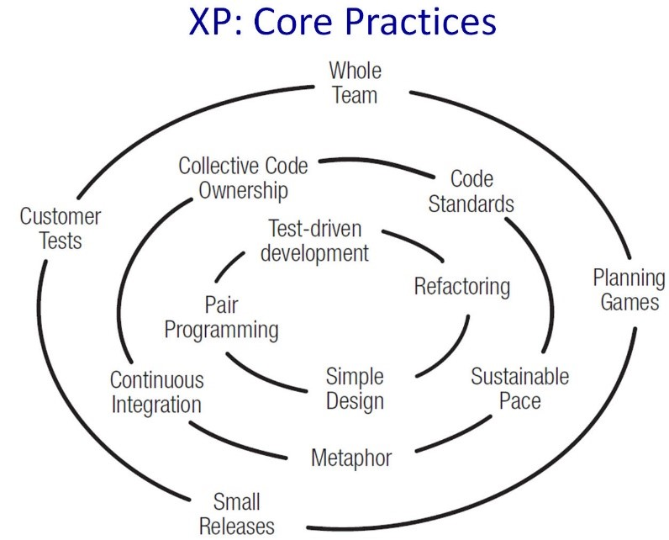
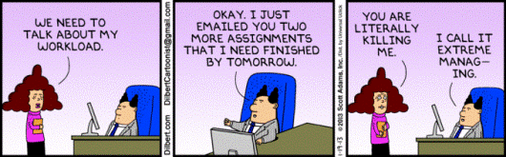
XP – Key Practices
Planning Game: All Members of the Team Should Participate in Planning – No Disconnect between Business and Technical People

Slide 20
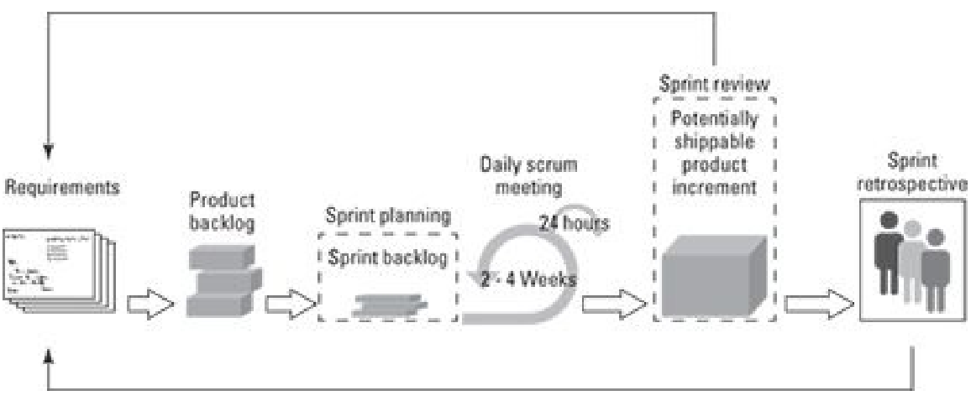
SCRUM – The Common Agile Project Management Framework
Product Owner: Responsible for End-to-end Product Development
SCRUM Master: Manages the SCRUM Process (Not a Manager of Teams)
Cross-functional Teams: Involving Developers, Designers, Testers, and Operations Teams

Slide 21
Agile Software Development - Summary
Customer and the Developer (Programmer) is at the Centre of any Agile Project Management Framework
Core Characteristics of Agile: Time-Boxed and Iterative Development (via Short Iterations or Sprints); Continuous Feedback; Direct Involvement of all Key Stakeholders; Constant Communication; Transparency; Cross-functional and Self-organizing Teams,..
Agile Methods: Lean (Kanban), XP and SCRUM
SCRUM is the Common Agile Framework adopted in most Software Product Organizations

Slide 22
Thank You
© Copyrights of original Authors are duly acknowledged
™ ® All Trademarks, Registered Trademarks referred in this document are the property of their respective owners

